Slide 1
Appiah and Haslanger on Race
PHI2010

Slide 2
Folk races
Folk race = a group of people that is talked about as belonging to a race in ordinary language (Spencer)
American Indians
Asians
Blacks
Pacific Islanders
Whites
Hispanic/Latino
Notes:
Spencer: the races recognized by the US government have become folk races
Why talk about folk races and not just races? To make it clear that we’re talking about the kinds of things that we ordinarily talk about when we talk about race, rather than some specialized conception of race that isn’t what we have in mind.
For example scientists use the term “race” to mean “subspecies,” but that’s not what we mean when we talk about how family wealth is distributed across different racial groups in the US.

Slide 3
What are folk races?
Someone belongs to folk race R just in case they have these features:
…
…
…
Goal is to give conditions that are:
Individually necessary: to belong to race R, you have to have all of the features
Jointly sufficient: if you have all the features, then that’s all it takes to belong to race R
Notes:
Our question for the next few classes: what are folk races? What is it to be white, or black, or Asian, for example?

Slide 4
What is a square?
X is a square just in case X has all of these features:
X is a two-dimensional geometric shape;
X has four sides of equal length; and
X’s sides meet to form four 90 degree angles.
Goal is to give conditions that are:
Individually necessary: to belong to race R, you have to have all of the features
Jointly sufficient: if you have all the features, then that’s all it takes to belong to race R
Notes:
Our question for the next few classes: what are folk races? What is it to be white, or black, or Asian, for example?

Slide 5
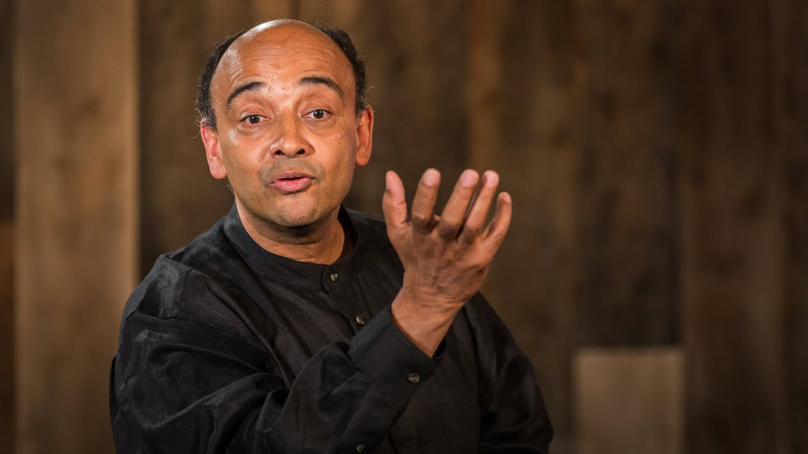
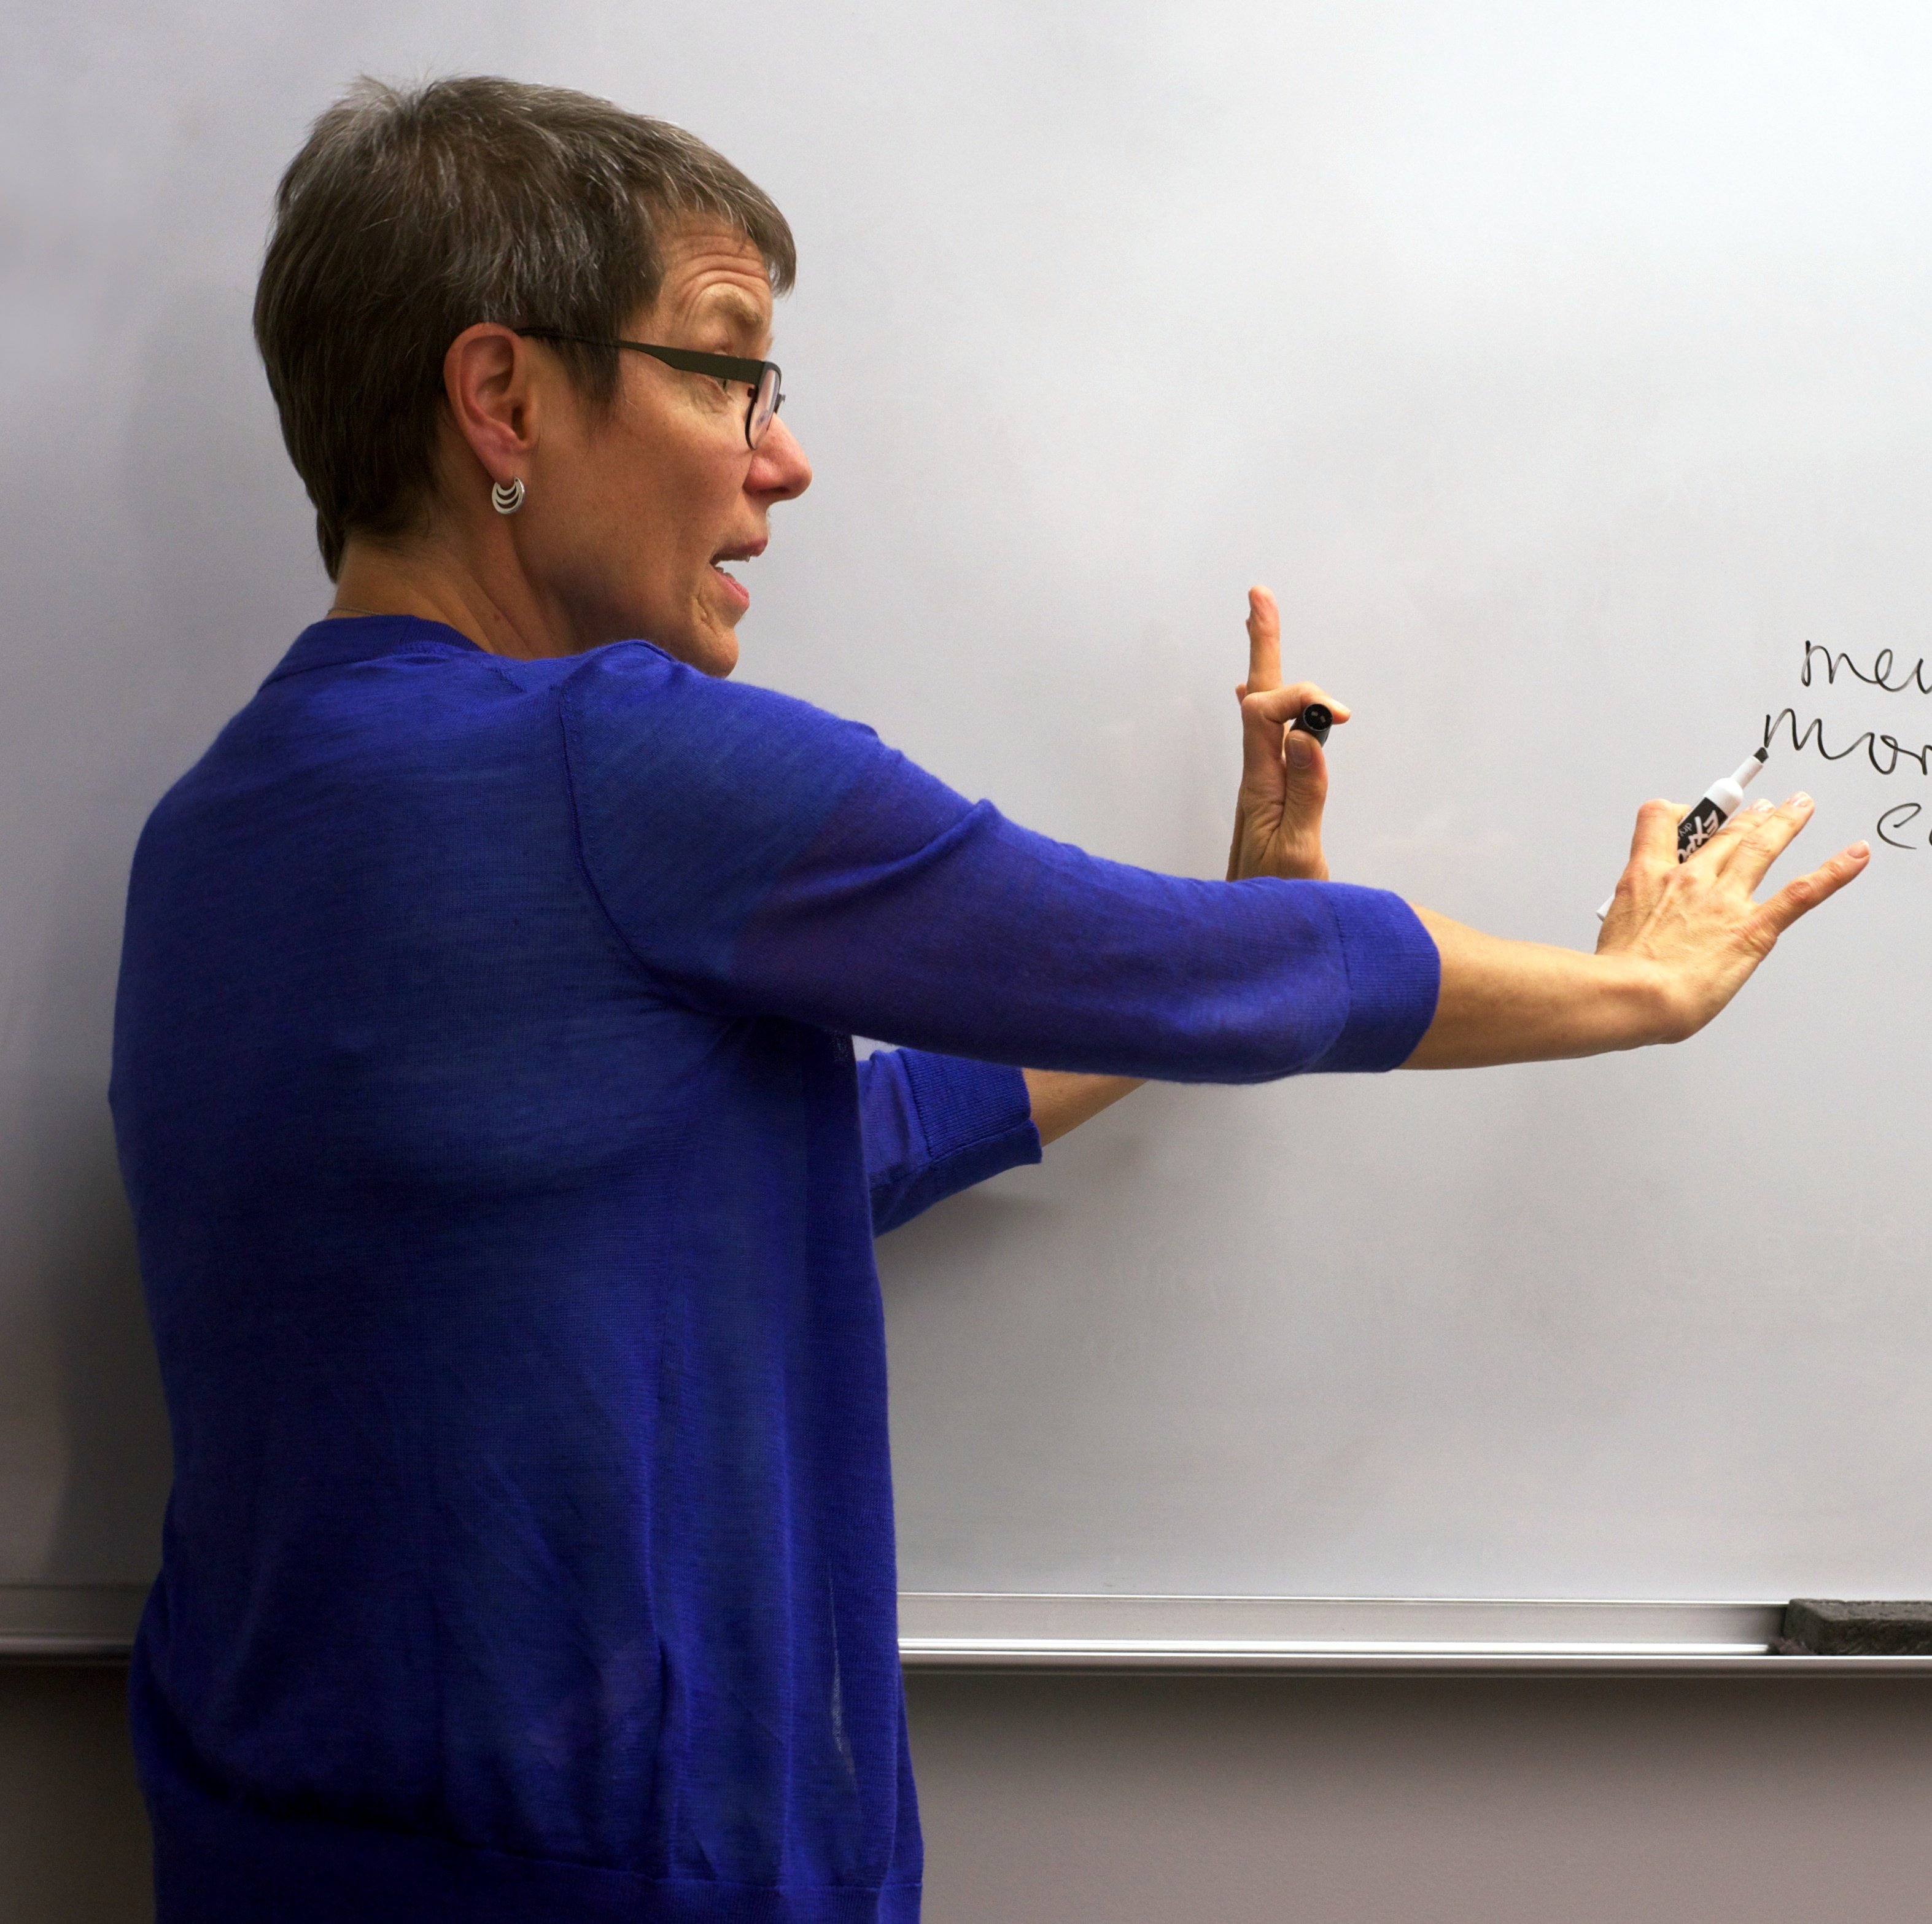
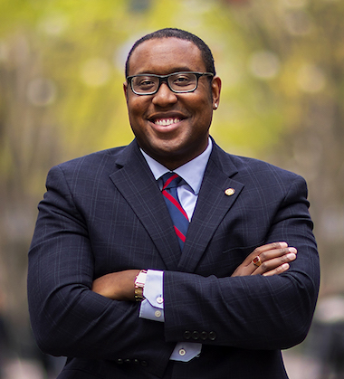
What are folk races?
Appiah
Folk races do not exist
(“Dodos”)
Haslanger
Folk races are social categories
(“Dimes”)
Quayshawn Spencer
Folk races are biological categories
(“Dingoes”)
Notes:
Spencer: the races recognized by the US government have become folk races
Why talk about folk races and not just races? To make it clear that we’re talking about the kinds of things that we ordinarily talk about when we talk about race, rather than some specialized conception of race that isn’t what we have in mind.
For example scientists use the term “race” to mean “subspecies,” but that’s not what we mean when we talk about how family wealth is distributed across different racial groups in the US.

Slide 6
Eliminativism
Realism
Appiah
Folk races do not exist
(“Dodos”)
Haslanger
Folk races are social categories
(“Dimes”)
Quayshawn Spencer
Folk races are biological categories
(“Dingoes”)
Notes:
Spencer: the races recognized by the US government have become folk races
Why talk about folk races and not just races? To make it clear that we’re talking about the kinds of things that we ordinarily talk about when we talk about race, rather than some specialized conception of race that isn’t what we have in mind.
For example scientists use the term “race” to mean “subspecies,” but that’s not what we mean when we talk about how family wealth is distributed across different racial groups in the US.

Slide 7
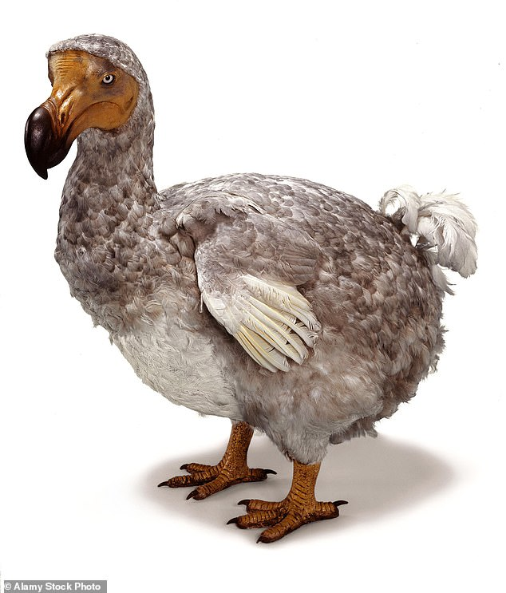
What are folk races?
“The truth is that there are no races: there is nothing in the world that can do all we ask ‘race’ to do for us. The evil that is done is done by the concept and by easy—yet impossible—assumptions as to its application.”
Appiah
Notes:
Spencer: the races recognized by the US government have become folk races
Why talk about folk races and not just races? To make it clear that we’re talking about the kinds of things that we ordinarily talk about when we talk about race, rather than some specialized conception of race that isn’t what we have in mind.
For example scientists use the term “race” to mean “subspecies,” but that’s not what we mean when we talk about how family wealth is distributed across different racial groups in the US.

Slide 8
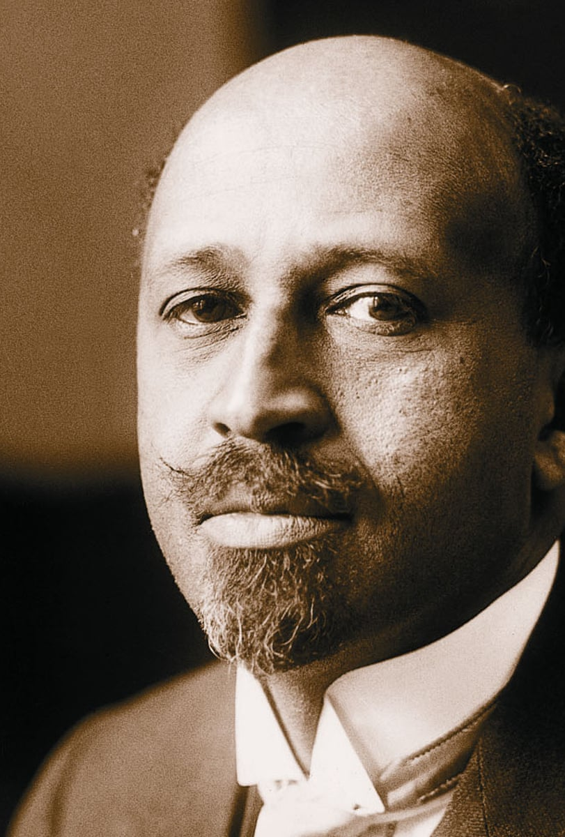
W.E.B. Du Bois (1868-1963)
American sociologist who studied race
Co-founder of the NAACP
First African American to receive Ph.D. from Harvard (1895)
“Called his life story the ‘autobiography of a race concept’”

Slide 9
“The Conservation of Races” (1897)
African Americans have “been led to … minimize race distinctions” because “back of most of the discussions of race with which he is familiar, have lurked certain assumptions as to his natural abilities, as to his political, intellectual and moral status, which he felt were wrong.”

Slide 10
The biological conception
Race “science” of the 19th century held that people of different races have different biological “essences” and that people of different races have different natural abilities and moral status
Du Bois rejects this on both scientific and moral grounds

Slide 11
The biological conception
“It is easy to see that scientific definition of race is impossible; it is easy to prove that physical characteristics are not so inherited as to make it possible to divide the world into races; that ability is the monopoly of no known aristocracy; that the possibilities of human development cannot be circumscribed by color, nationality, or any conceivable definition of race.”

Slide 12
The biological conception
Commonality problem: race science has failed to identify biological properties that could play the roles that races were supposed to play
i.e., no basis in biology for thinking that racial differences are biologically “deep” / correspond to differences in natural ability
Normativity problem: the biological conception of race falsely assumes that people of some races matter more from a moral point of view, and is used to justify oppressive practices (e.g. slavery, colonialism, segregation)
Notes:
These are Haslanger’s terms

Slide 13
Race as social category
“Nevertheless, in our calmer moments we must acknowledge that human beings are divided into races”
“[A]s I face Africa I ask myself: what is it between us that constitutes a tie which I can feel better than I can explain?”

Slide 14

Pan-Africanism
The view that “African people, both on the continent and in the diaspora, share not merely a common history, but a common destiny”
Minkah Makalani (2011)

Slide 15
Project
Give an account of what it is to be Black that
Solves the Commonality Problem by identifying features that all Black people share (individually necessary and jointly sufficient)
Solves the Normativity Problem by rejecting the view that Whites are superior (in terms of moral status or natural abilities)
Is useful for Sociological Theorizing—for understanding the role race plays in society

Slide 16
Race as social category
“The physical bond [among people of direct African descent] is least and the badge of color relatively unimportant save as a badge”

Slide 17
“Color” as the physical indicators of race
Du Bois: “The physical bond [among people of direct African descent] is least and the badge of color relatively unimportant save as a badge…”
Haslanger: “I will use the term ‘color’ to refer to the (contextually variable) physical ‘markers’ of race. … I mean to include in ‘color’ more than just skin tone: common markers also include eye, nose, and lip shape, hair texture, physique, etc.”

Slide 18
Race as social category
“[T]hroughout the world today organized groups of men by monopoly of economic and physical power, legal enactment and intellectual training are limiting with determination and unflagging zeal the development of other groups; and that the concentration particularly of economic power today puts the majority of mankind into a slavery to the rest.”

Slide 19
Race as social category
“[T]he real essence of this kinship is its social heritage of slavery; the discrimination and insult; and this heritage binds together not simply the children of Africa, but extends through ... Asia and the South Seas. It is this unity that draws me to Africa.”

Slide 20
Race as social category
“The black man is a person who must ride ‘Jim Crow’ in Georgia.”
I.e., to be Black is to be marginalized by society in a certain way

Slide 21
“Du Bois’ experience of ‘discrimination and insult’ in his American childhood and as an adult citizen of the industrialized world was different in character from that experienced by, say, Kwame Nkrumah in colonized West Africa; it is absent altogether in large parts of [Asia].”
Notes:
Spencer: the races recognized by the US government have become folk races
Why talk about folk races and not just races? To make it clear that we’re talking about the kinds of things that we ordinarily talk about when we talk about race, rather than some specialized conception of race that isn’t what we have in mind.
For example scientists use the term “race” to mean “subspecies,” but that’s not what we mean when we talk about how family wealth is distributed across different racial groups in the US.

Slide 22
Du Bois’ attempt to give an account of what it is to be black in terms of social marginalization fails because Black people from different parts of the world are not all socially marginalized in the same ways
Defining “Black” in terms of social marginalization fails to yield an explanatorily useful social category—a category that can help us explain what race is supposed to explain about how society works
Notes:
Spencer: the races recognized by the US government have become folk races
Why talk about folk races and not just races? To make it clear that we’re talking about the kinds of things that we ordinarily talk about when we talk about race, rather than some specialized conception of race that isn’t what we have in mind.
For example scientists use the term “race” to mean “subspecies,” but that’s not what we mean when we talk about how family wealth is distributed across different racial groups in the US.

Slide 23
“The truth is that there are no races: there is nothing in the world that can do all we ask ‘race’ to do for us.”
Notes:
Spencer: the races recognized by the US government have become folk races
Why talk about folk races and not just races? To make it clear that we’re talking about the kinds of things that we ordinarily talk about when we talk about race, rather than some specialized conception of race that isn’t what we have in mind.
For example scientists use the term “race” to mean “subspecies,” but that’s not what we mean when we talk about how family wealth is distributed across different racial groups in the US.

Slide 24
Du Bois’ attempt to give an account of what it is to be black in terms of social marginalization fails because Black people from different parts of the world are not all socially marginalized in the same ways
“Color” is loosely correlated with racial group membership, but folk races defined in terms of shared color can’t play the explanatory roles Du Bois wants them to play
Notes:
Spencer: the races recognized by the US government have become folk races
Why talk about folk races and not just races? To make it clear that we’re talking about the kinds of things that we ordinarily talk about when we talk about race, rather than some specialized conception of race that isn’t what we have in mind.
For example scientists use the term “race” to mean “subspecies,” but that’s not what we mean when we talk about how family wealth is distributed across different racial groups in the US.

Slide 25
“The truth is that there are no races: there is nothing in the world that can do all we ask ‘race’ to do for us. The evil that is done is done by the concept and by easy—yet impossible—assumptions as to its application.”
Notes:
Spencer: the races recognized by the US government have become folk races
Why talk about folk races and not just races? To make it clear that we’re talking about the kinds of things that we ordinarily talk about when we talk about race, rather than some specialized conception of race that isn’t what we have in mind.
For example scientists use the term “race” to mean “subspecies,” but that’s not what we mean when we talk about how family wealth is distributed across different racial groups in the US.

Slide 26
“The truth is that there are no races: there is nothing in the world that can do all we ask ‘race’ to do for us. The evil that is done is done by the concept and by easy—yet impossible—assumptions as to its application.”
There is no race, only racialization = categorizing someone as belonging to a particular race
Notes:
Spencer: the races recognized by the US government have become folk races
Why talk about folk races and not just races? To make it clear that we’re talking about the kinds of things that we ordinarily talk about when we talk about race, rather than some specialized conception of race that isn’t what we have in mind.
For example scientists use the term “race” to mean “subspecies,” but that’s not what we mean when we talk about how family wealth is distributed across different racial groups in the US.

Slide 27
Folk race = a group of people that is talked about as belonging to a race in ordinary language (Spencer)
American Indians
Asians
Blacks
Pacific Islanders
Whites
Hispanic/Latino
Appiah thinks that folk races don’t exist. Strictly speaking, there is no such think as being a Pacific Islander, for example. Is he right?
Notes:
Spencer: the races recognized by the US government have become folk races
Why talk about folk races and not just races? To make it clear that we’re talking about the kinds of things that we ordinarily talk about when we talk about race, rather than some specialized conception of race that isn’t what we have in mind.
For example scientists use the term “race” to mean “subspecies,” but that’s not what we mean when we talk about how family wealth is distributed across different racial groups in the US.

Slide 28
Eliminativism
Realism
Appiah
Folk races do not exist
(“Dodos”)
Haslanger
Folk races are social categories
(“Dimes”)
Quayshawn Spencer
Folk races are biological categories
(“Dingoes”)
Notes:
Spencer: the races recognized by the US government have become folk races
Why talk about folk races and not just races? To make it clear that we’re talking about the kinds of things that we ordinarily talk about when we talk about race, rather than some specialized conception of race that isn’t what we have in mind.
For example scientists use the term “race” to mean “subspecies,” but that’s not what we mean when we talk about how family wealth is distributed across different racial groups in the US.

Slide 29
Isn’t it obvious that races exist?
“Nevertheless, in our calmer moments we must acknowledge that human beings are divided into races”

Slide 30
Race as social category
“The self-evidence of racial distinctions in everyday American life is at striking odds with the uncertainty about the category of race in law and the academy. Work in the biological sciences has informed us that our practices of racial categorization don't map neatly onto any useful biological classification; but that doesn't settle much, if anything. For what should we make of our tendency to classify individuals according to race, apparently on the basis of physical appearance? And what are we to make of the social and economic consequences of such classifications? Is race real or is it not?”

Slide 31
Race as social category
Haslanger is influenced by Du Bois’ conception of race, and thinks Appiah’s objection can be answered
“The black man is a person who must ride ‘Jim Crow’ in Georgia.”
I.e., to be black is to be marginalized by society in a certain way

Slide 32
Three approaches to giving an account of what race is
Conceptual – what do we think race is? What do we think terms like “white” and “black” mean?
Descriptive – what is race, really? What kinds of features actually unify the groups of people that we use terms like “white” and “black” to refer to?
Analytical – regardless of the concept of race we actually have, what concept of race should we have? What should we use terms like “white” and “black” to mean?

Slide 33
The analytical approach
“[O]n an analytical approach, the questions ‘What is gender?’ or ‘What is race?’ require us to consider what work we want these concepts to do for us; why do we need them at all? The responsibility is ours to define them for our purposes. In doing so we will want to be responsive to some aspects of ordinary usage. . . . However, neither ordinary usage nor empirical investigation is overriding, for there is a stipulative element to the project: this is the phenomenon we need to be thinking about. Let the term in question refer to it. On this approach, the world can’t tell us what gender is, or what race is; it is up to us to decide what in the world, if anything, they are.”

Slide 34
Two facts about race to accommodate:
(1) “there are no racial genes responsible for the complex morphologies and cultural patterns we associate with different races.”
(2) “in different contexts racial distinctions are drawn on the basis of different characteristics, e.g., the Brazilian and US classification schemes for who counts as ‘Black’ differ.”
“[I]t appears that race … could be fruitfully understood as a position within a broad social network.”

Slide 35
Race is the social meaning of “color”
“I will use the term ‘color’ to refer to the (contextually variable) physical ‘markers’ of race. … I mean to include in ‘color’ more than just skin tone: common markers also include eye, nose, and lip shape, hair texture, physique, etc.”
“[R]ace is the social meaning of geographically marked body, familiar markers being skin color, hair type, eye shape, physique.”

Slide 36
Racialization
“A group is racialized iff its members are socially positioned as subordinate or privileged along some dimension (economic, political, legal, social, etc.) and the group is ‘marked’ as a target for this treatment by observed or imagined bodily features presumed to be evidence of ancestral links to a certain geographical region.”
Race
“S is of the White (Black, Asian...) race iff Whites (Blacks, Asians…) are a racialized group, and S is a member.”

Slide 37
“S is of the White (Black, Asian...) race iff Whites (Blacks, Asians…) are a racialized group, and S is a member.”
It follows that your race (and whether you have one) depends on social context:
“For example, Blacks, Whites, Asians, Native Americans, are currently racialized in the US insofar as these are all groups defined in terms of physical features associated with places of origin, and insofar as membership in the group functions socially as a basis for evaluation.”

Slide 38
“S is of the White (Black, Asian...) race iff Whites (Blacks, Asians…) are a racialized group, and S is a member.”
It follows that your race (and whether you have one) depends on social context:
“However, some groups are not currently racialized in the US, but have been so in the past and possibly could be again (and in other contexts are), e.g., the Italians, the Germans, the Irish….”

Slide 39

Racialization
“A group is racialized iff its members are socially positioned as subordinate or privileged along some dimension (economic, political, legal, social, etc.) and the group is ‘marked’ as a target for this treatment by observed or imagined bodily features presumed to be evidence of ancestral links to a certain geographical region.”
Race
“S is of the White (Black, Asian...) race iff Whites (Blacks, Asians…) are a racialized group, and S is a member.”
“Oprah Winfrey is one of the richest African Americans, is a recipient of the Presidential Medal of Freedom, and is sometimes said to be the most influential woman in the world. Would Haslanger deny that she is [Black]? If not, why not?”

Slide 40
A worry
“Isn’t there something disingenuous about appropriating race and gender terminology because it is used to frame how twe think of ourselves and each other, in order to use them for new concepts that are not part of our self-understandings?
This latter question is especially pressing because the appropriation under consideration intentionally invokes what many find to be positive self-understandings—being Latina, being a White man—and offers analyses of them which emphasize the broader context of injustice. Thus there is an invitation not only to revise one's understanding of these categories (given their instability, this happens often enough), but to revise one’s relationship to their prescriptive force.”

Slide 41
Response
“By offering these analyses of our ordinary terms, I call upon us to reject what seemed to be positive social identities. I'm suggesting that we should work to undermine those forces that make being a man, a woman, or a member of a racialized group possible; we should refuse to be gendered man or woman, refuse to be raced.
…
In one sense this appropriation is ‘just semantics’: I'm asking us to use an old term in a new way. But it is also politics: I'm asking us to understand ourselves and those around us as deeply molded by injustice and to draw the appropriate prescriptive inference. This, I hope, will contribute to empowering critical social agents.”

Slide 42
Race
“S is of the White (Black, Asian...) race iff Whites (Blacks, Asians…) are a racialized group, and S is a member.”
Racialization
“A group is racialized iff its members are socially positioned as subordinate or privileged along some dimension (economic, political, legal, social, etc.) and the group is ‘marked’ as a target for this treatment by observed or imagined bodily features presumed to be evidence of ancestral links to a certain geographical region.”
Discussion questions
Is this conception of race useful for Du Bois’ project—understanding the role race plays in our society?
Does Haslanger’s account categorize people in approximately the same way that we ordinarily categorize people by race? Are there important differences?
Why might someone think that understanding and talking about race in the way Haslanger does is useful for addressing injustice? Is that right?
Is it a problem that Haslanger’s account treats belonging to a racial group as a bad thing? How satisfying is her response to that worry?

Slide 43
Eliminativism
Realism
Appiah
Folk races do not exist
(“Dodos”)
Haslanger
Folk races are social categories
(“Dimes”)
Quayshawn Spencer
Folk races are biological categories
(“Dingoes”)
Notes:
Spencer: the races recognized by the US government have become folk races
Why talk about folk races and not just races? To make it clear that we’re talking about the kinds of things that we ordinarily talk about when we talk about race, rather than some specialized conception of race that isn’t what we have in mind.
For example scientists use the term “race” to mean “subspecies,” but that’s not what we mean when we talk about how family wealth is distributed across different racial groups in the US.

